Slide 1
Prepared by:
Syed Hamid Pasha
McLaren P1

Slide 2

McLaren P1

Slide 3
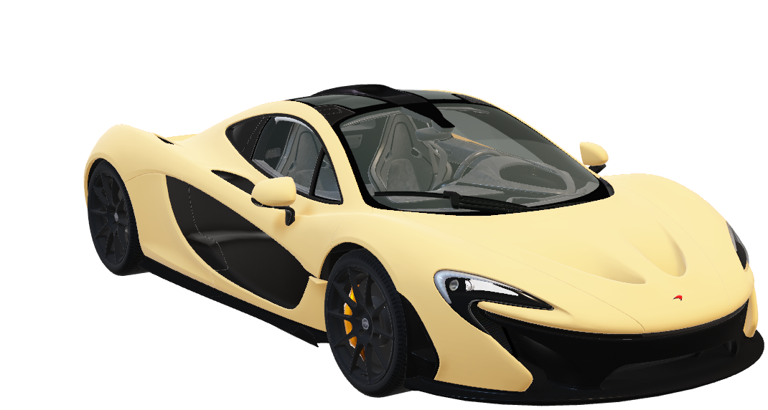
McLaren P1
Hybrid Hypercar, Pure Experience
A track-bred masterpiece that fuses electric surge with a high-revving combustion heart, married to a carbon-fiber monocoque, active aerodynamics and race-derived chassis.
Instant acceleration, surgical handling and a visceral soundtrack deliver a full-sensory drive, while hand-finished details and extreme rarity make ownership a statement of engineered luxury.

Slide 4






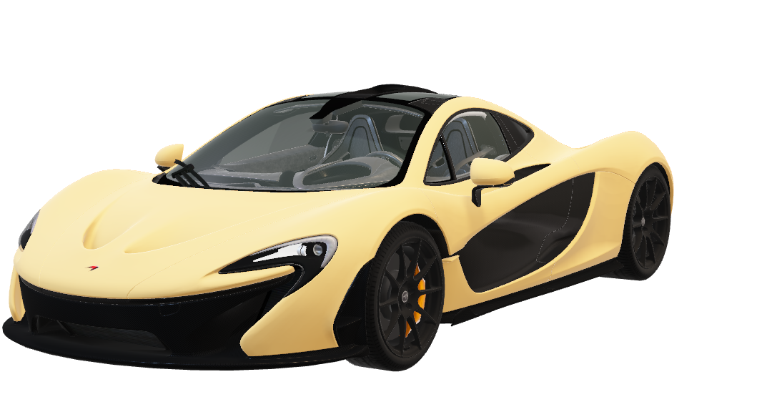
McLaren P1
Details:
350 Kmph
Top Speed
903 HP
Horse Power
0-100 Kmph
2.8s
194g/km
CO2 Emissions
3,799cc
Engine Capacity
1,395kg (Lightest)
Dry Weight

Slide 5
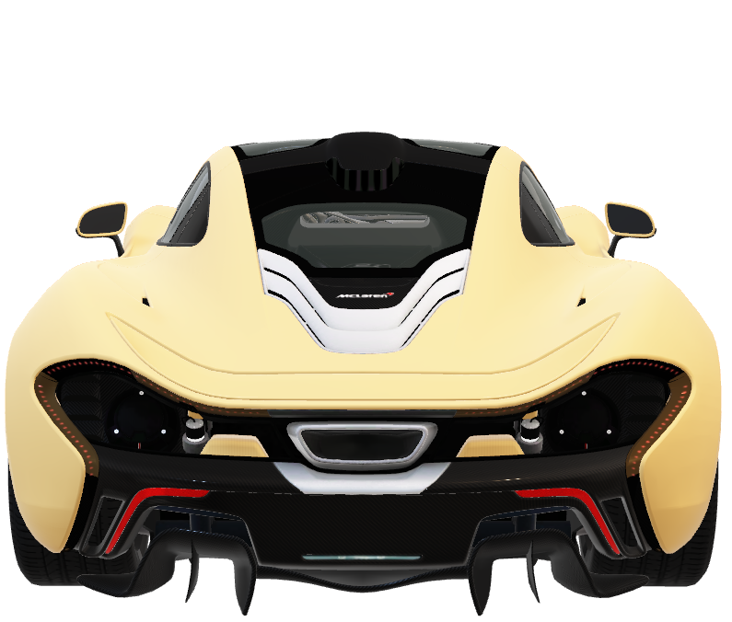
Sculpted for speed, crafted to captivate.
McLaren P1
The McLaren P1's tight-fitting carbon-fiber figure and active aerodynamics are perfectly combined — every surface was adjusted for the minimum drag and maximum racing character. Thus, the car is able to exude both stunning visual elegance and performance that is hard to compromise.
Details:
350 Kmph
Top Speed
0-100 Kmph
2.8s
3,799cc
Engine Capacity

Slide 6
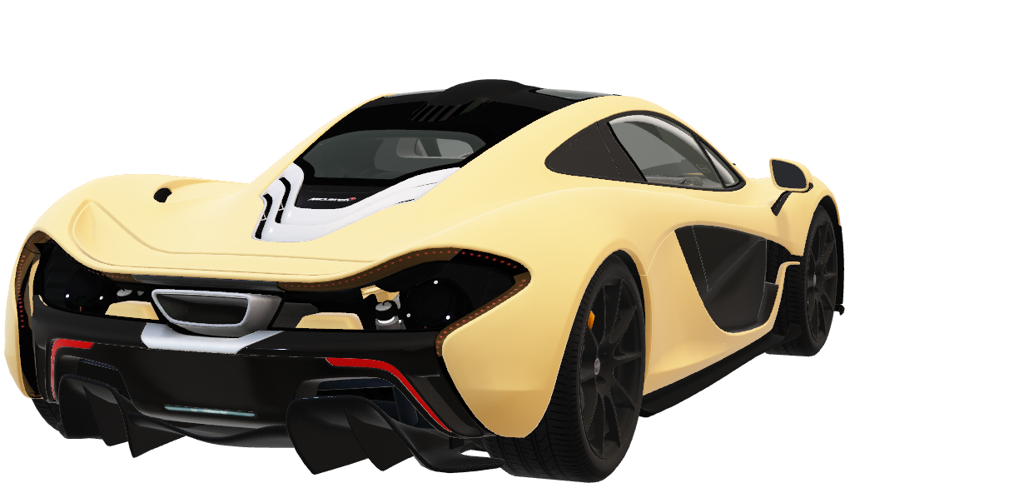
THE HYBRID HEART
This isn't just a car. It's a predator. A furious twin-turbo V8 fused with an F1-derived electric motor unleashes a savage, instantaneous flood of 903 horsepower.
The result is not just acceleration; it's a recalibration of speed itself. An experience so responsive, it feels less mechanical, more telepathic.
McLaren P1

Slide 7
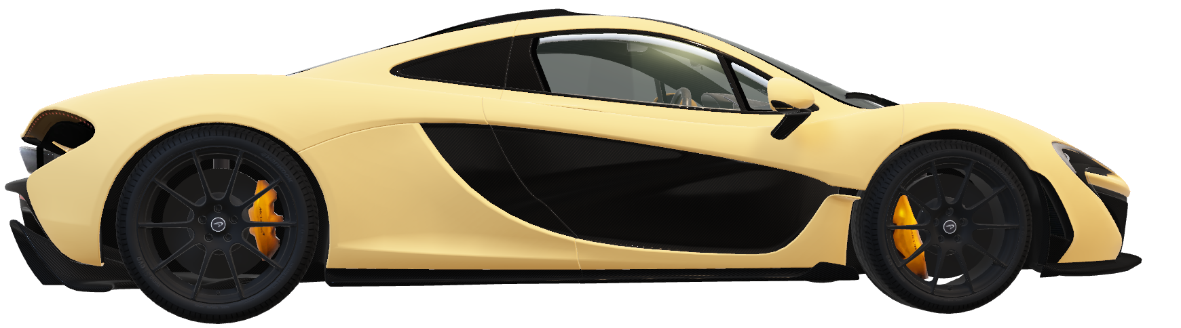
Define Your Legacy

Slide 8


